Slide 1

Outreach Awards
The Bionic Tigers - FTC 10464

Slide 2
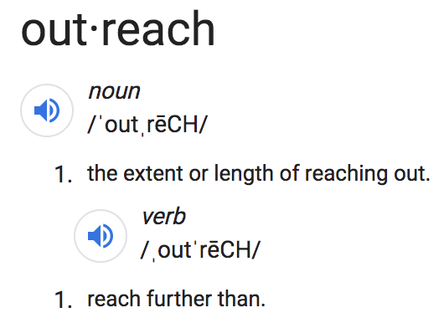
Outreach
Core Values: Impact, Inclusion, Fun

Slide 3
Three Main Types of Outreach
Professional - Connect
Community - Motivate
FIRST - Motivate

Slide 4
Motivate Award

Slide 5
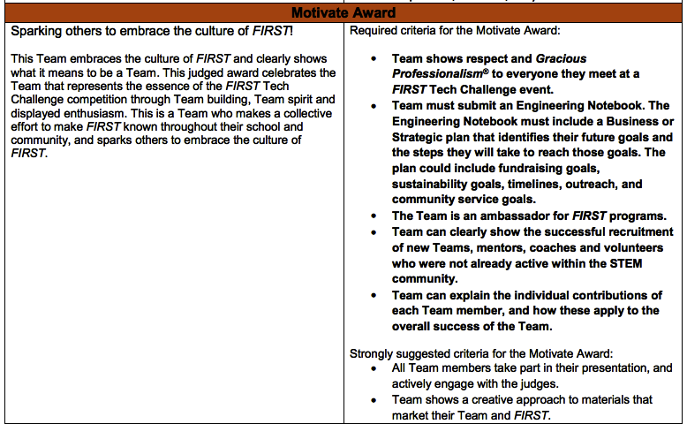
Definition
Motivate Award
Gracious Professionalism
Engineering Notebook
FIRST Ambassador
Outreach
Contribution
Presentation
This team embraces the culture of FIRST and clearly shows what it means to be a Team. This judged award celebrates the Team that represents the essence of the FIRST Tech Challenge competition through Team building, Team spirit and displayed enthusiasm. This is a Team who makes a collective effort to make FIRST known throughout their school and community, and sparks others to embrace the culture of FIRST.

Slide 6
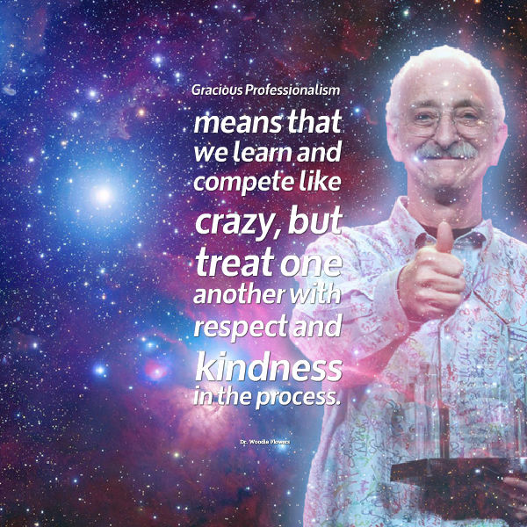
Woodie Flowers, Distinguished Advisor to FIRST
Teams show respect and Gracious Professionalism® to everyone they meet at a FIRST Tech Challenge event.
What is Gracious Professionalism®?
Understanding that this is a learning experience for everyone and supporting one another
What does “everyone” mean?
The idea is that:
Every team against the game, not team vs team
Be supportive of each other and help each other out

Slide 7
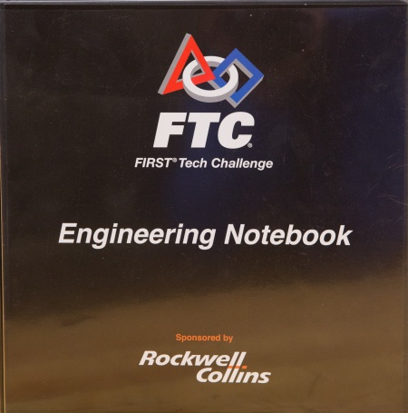
Teams must submit an Engineering Notebook.
Clear documentation
Include visuals
Record stats
The Engineering notebook must include a Business or Strategic plan that identifies their future goals and the steps they will take to reach those goals.
The plan could include fundraising goals, sustainability goals, timelines, outreach, and community service goals

Slide 8
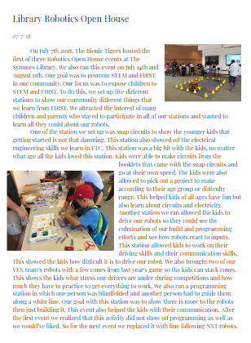
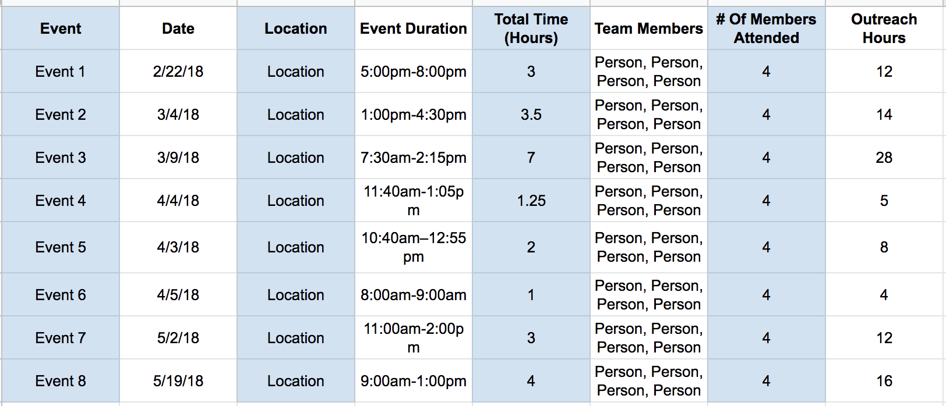
Examples

Slide 9
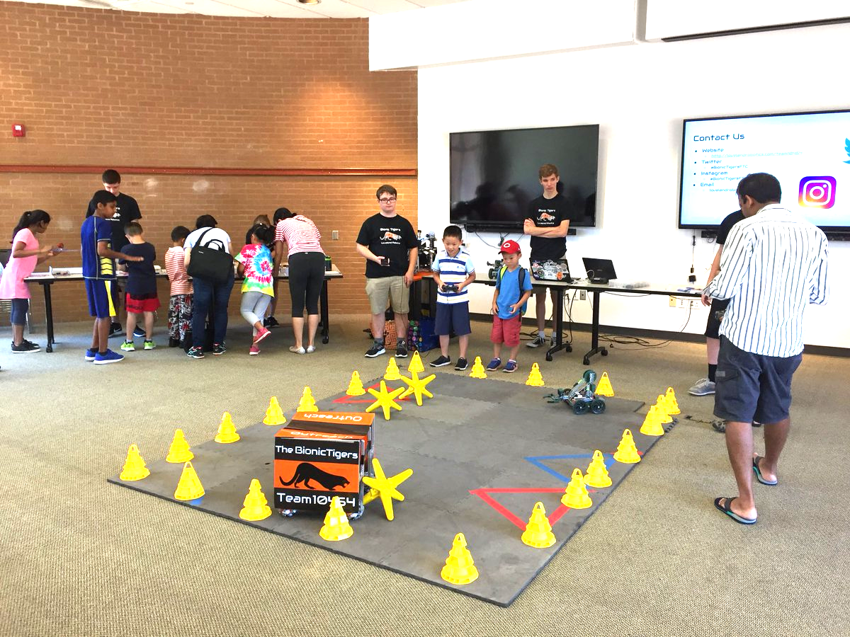
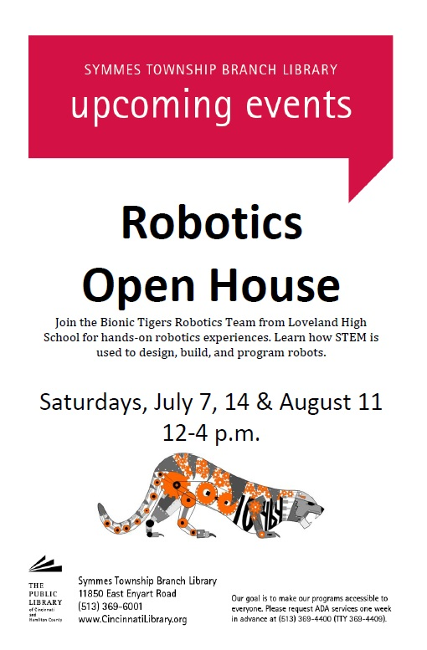
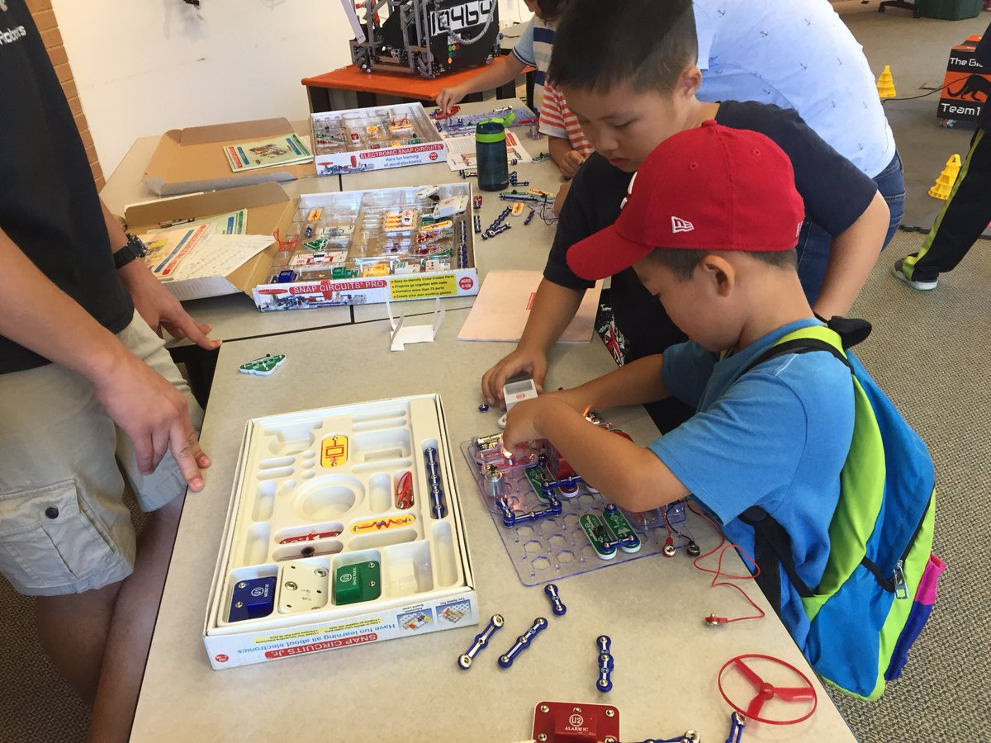
Team is an ambassador for FIRST programs
An Ambassador means that you are the in between of your community and FIRST Robotics.
Presence in your community
Make it loud
Share your passion
Example: We tweet back and forth with our school faculty to share how active we are

Slide 10
Team is an ambassador for FIRST programs
Quantity of Outreach
Hours
Demos
Library
Younger schools
Museums
Quality of Outreach
Have a purpose
Have variety
Show passion for it in presentation

Slide 11
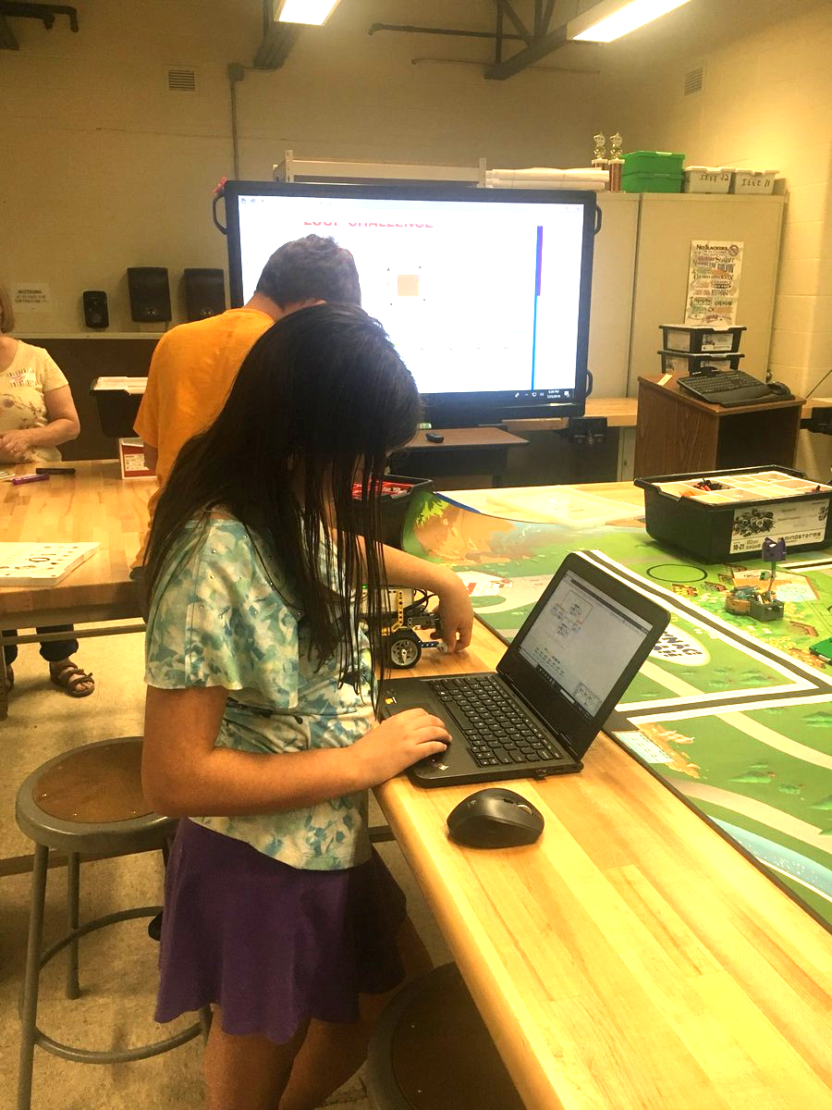

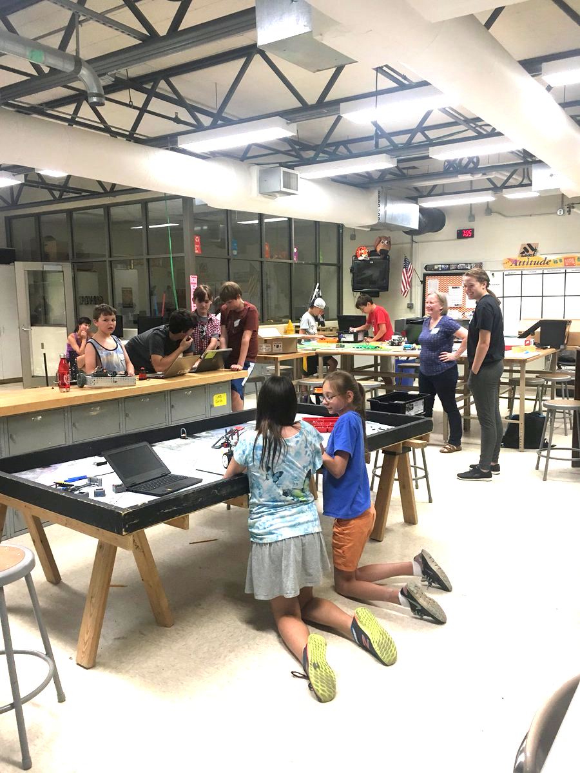
Teams can clearly show the successful recruitment of new teams, mentors, coaches and volunteers who were not already active within the STEM community.
Grow your team
Leaving a legacy
FLL mentoring
Growing our program (From 2 teams to 10+ and adding Boosters)

Slide 12
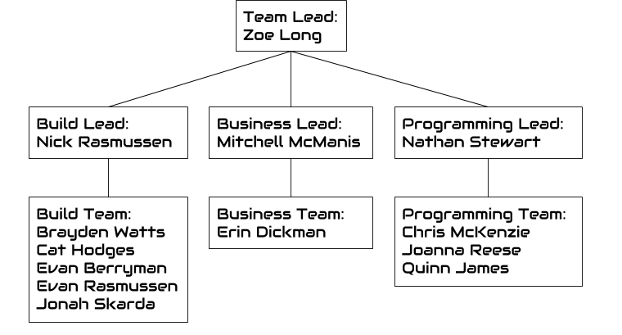
Team can explain the individual contributions of each team member, and how these apply to the overall success of the Team.
Presentations
Prepare to answer any question
Be memorable
Having clear team structure
Take pictures of each team member working for the notebook
Sign pages in notebook

Slide 13
Connect Award

Slide 14
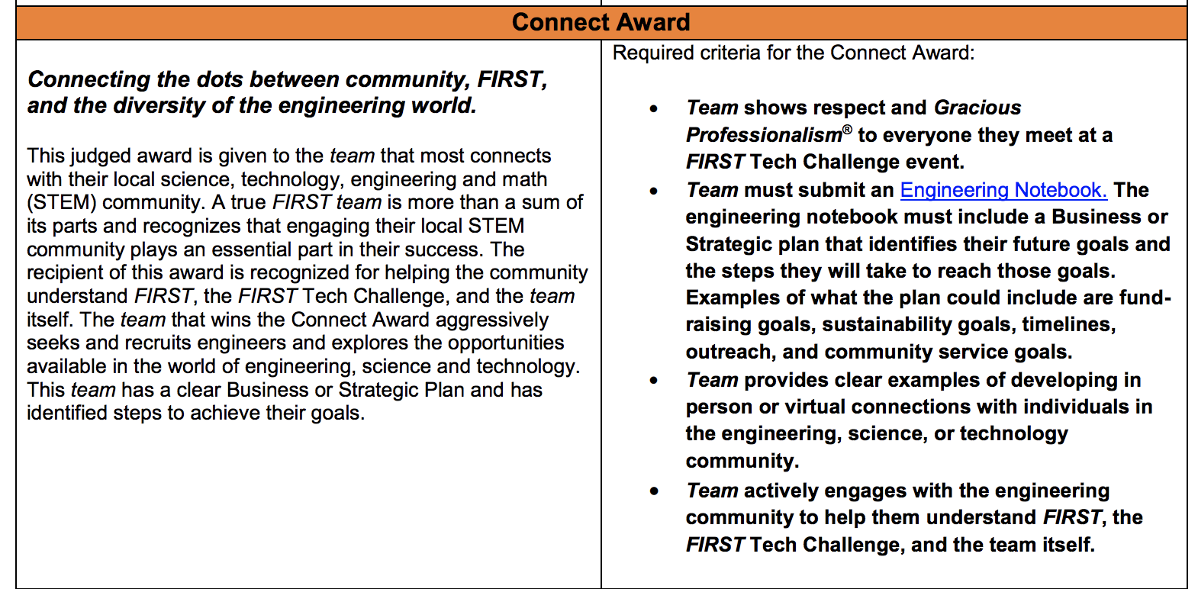
Definition
Gracious Professionalism
Engineering Notebook
Documentation
Professionals in community
Contribution
Presentation

Slide 15
Team provides clear examples of developing in person or virtual connections with individuals in the engineering, science, or technology community
Relevant Quality Elements:
Teamwork; Enthusiasm; Communication; Outreach; Funding Plan; Networking
DO NOT BE AFRAID TO REACH OUT!

Slide 16
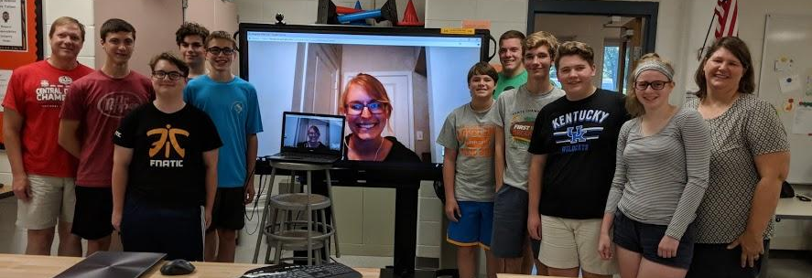
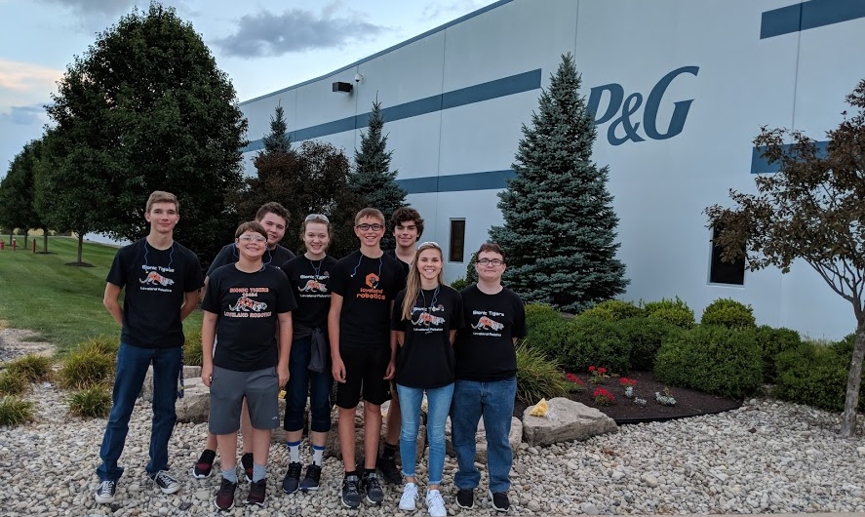
Team actively engages with the engineering community to help them understand FIRST, the FIRST Tech Challenge, and the team itself
Tours
Learning
Mentors

Slide 17
What is the difference?
The focus of the outreach:
Community and FIRST (MOTIVATE)
vs
Professional (CONNECT)

Slide 18
Summary
Create a balance between types of outreach

Slide 19


Credits
This lesson was written by The Bionic Tigers 10464 for FTCTutorials.com
You can contact the author at:
Website:
http://lovelandrobotics.com/team10464
Twitter:
@BionicTigersFTC
Email:
BionicTigers10464@gmail.com
More lessons for FIRST Tech Challenge are available at www.FTCtutorials.com
This work is licensed under a
Creative Commons Attribution-NonCommercial-ShareAlike 4.0 International License.

